Slide 1



CITI BRIDGE PROGRAM
2022
Group Members
Gargi Joshi
Rutuja Ghorpade
Shivani Mohankumar
Yamini Dongaonkar
Mansi Indore
Group No.: 1
Group Mentor
Harsh Singhal

Slide 2

Sanction screening
of payments transactions

Slide 3



AGENDA:
What is Sanction screening?
Technology
Used
Data flow diagram
Features
Journey
through the program
Demo
Q&A

Slide 4
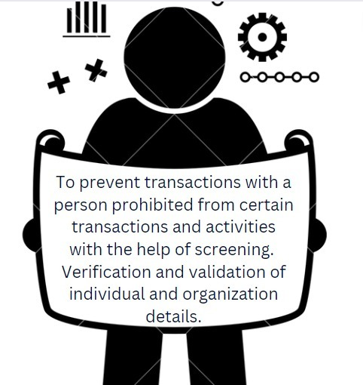

WHAT IS SANCTION
SCREENING?

Slide 5









Features
Login Page
Upload File
Validation
Sanctioning
Display
sanctions

Slide 6





TECHNOLOGY STACK:

Slide 7
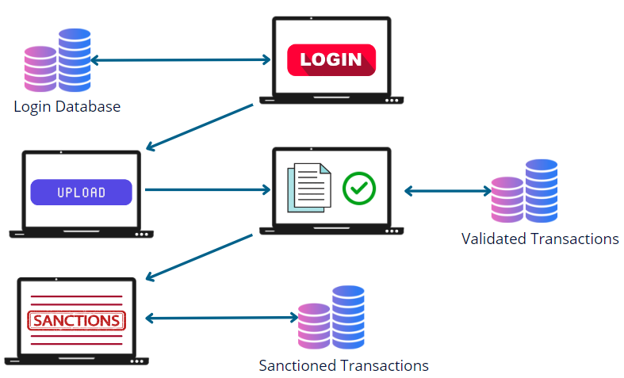
DATA FLOW

Slide 8
DEMO

Slide 9
Journey through the program

Slide 10
THANK YOU

Slide 11
ANY QUESTIONS?

